Slide 1

Neo Bank
New Age Banking and Data Storage Solutions

Slide 2

World Leading Security
Neo Bank is providing world class security for both Money and Data.
With branchless online operation of banking and a distrubuted blockchain based banking approach has made Neo Bank a Leader in Paperless Banking and Cloud Storage Solutions.
We understand that as your business grows, data produced by your business will grow eventually. Data being a part of our daily life, now will be hosted on Neo Bank servers and its storage capacity will be allocated based on amount balance in your account

Slide 3
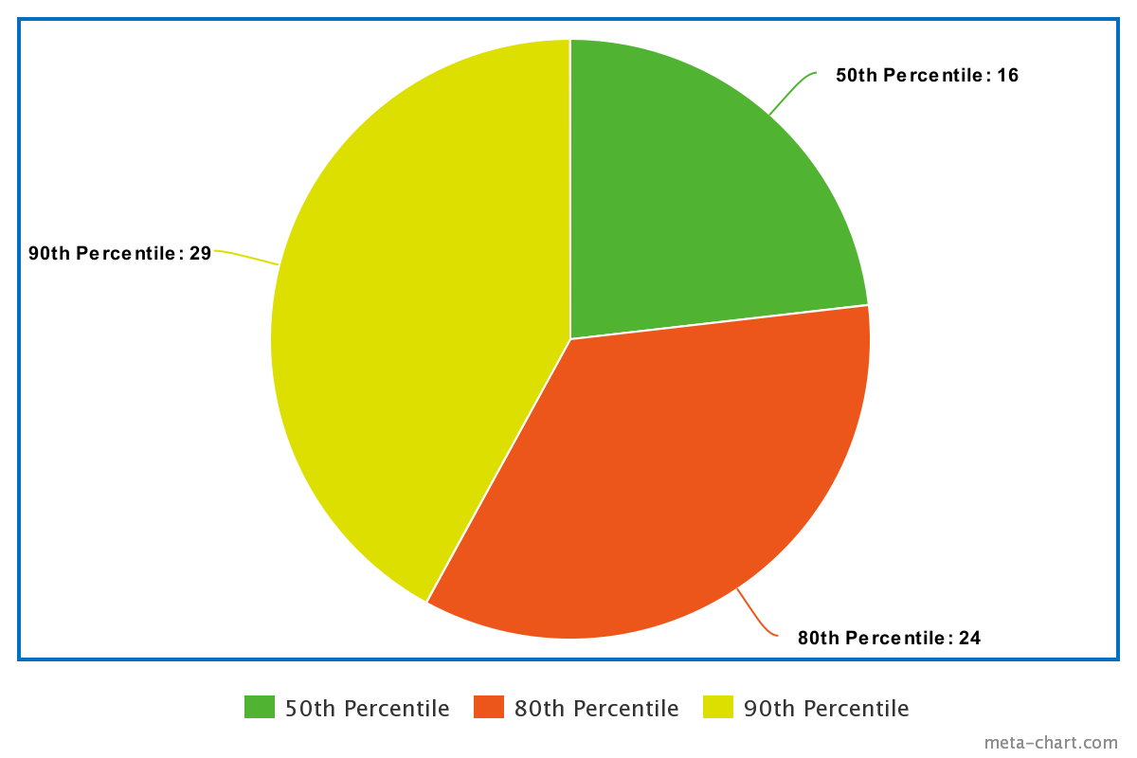
Security Insights
On average customers are allocated to a new node within 16 days.

Slide 4
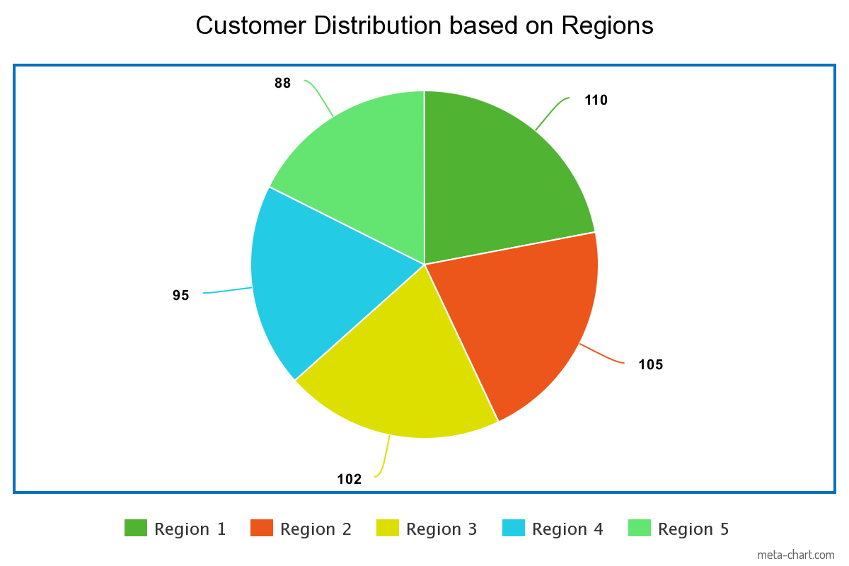
Security Insights
Our servers are distributed in 5 regions each having 5 nodes which stores user data.

Slide 5

Dive into future banking with

